Slide 1
Deep Neural Networks & Convolutional Neural Networks

Slide 2
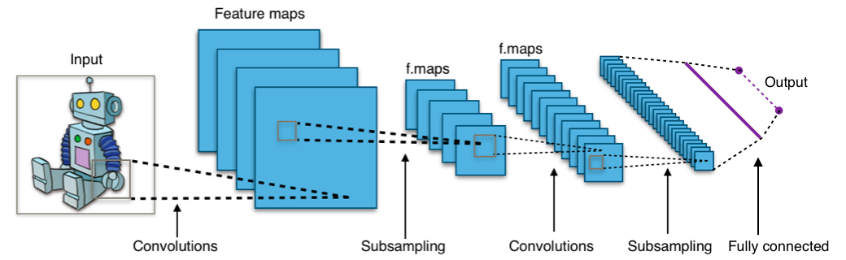
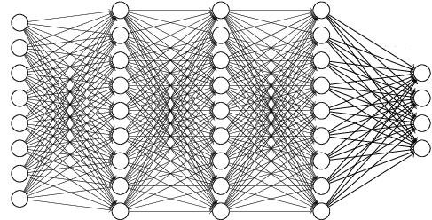
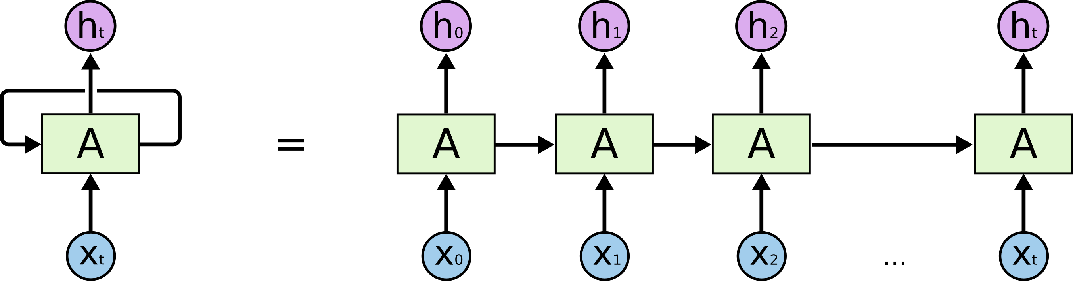
Practice 1
Next word prediction (Language Model)
Predict the next word using previous k words
Ex) It is too late I want to go ???
<Convolutional Neural Network>
<Dense Network>
<Recurrent Neural Network>

Slide 3
Practice 1: DNN
It
is
too
.
.
.
???
.
.
.
to
go
Input Layer
Hidden Layer
Output Layer

Slide 4
Practice 1: DNN
Data Set
Penn Tree Bank (PTB) dataset
Widely used in machine learning of NLP
Relatively small size of data
Widely use to evaluate performance of model
Total number : 49,000 sentences (5MB)
Vocabulary : 10,000
Example)
longer maturities are thought to indicate declining interest rates because they permit portfolio managers to retain relatively higher rates for a longer period
shorter maturities are considered a sign of rising rates because portfolio managers can capture higher rates sooner

Slide 5
Practice 1: DNN
Step
Preprocessing
Build Model
Train Model

Slide 6
Practice 1: DNN
Preprocessing
Word ID and word correspondence
Each word ID corresponds to specific word or symbol
Symbol
<unk> : unknown word (no in the 10000 vocabulary)
Relation between word ID and word is stored as dictionary
{'representation': 7975, 'competent': 9733, 'unusual': 2825, 're-election': 2672, 'brewing': 7045, 'stunning': 9451, 'distributed': 6252, 'percentage': 72, 'compare': 2549, 'laughing': 3407, 'sci': 3311, 'suggested': 2611, 'incompetent': 9769, 'sandinistas': 9108, 'werner': 8877, 'poison': 6210, 'salon': 3963, 'now': 145, 'crest': 8679, 'dairy': 2018, 'lineup': 9597, 'hills': 1264, 'chip': 1157, 'creditor': 1374, 'actor': 2315, 'specialist': 2737, "'s": 119, 'flooded': 3700, 'aba': 3364, ... }

Slide 7
Practice 1: DNN
Preprocessing
Word to ID
Given new word, store word to index in w2idx list
ID to Word
store the convert back index to word in idx2w list
def file_to_ids(self, file_name): with open(file_name, "r") as fin: lines = fin.readlines() length, ids = [], [] for num, line in enumerate(lines): id = [] words = line.split() for i, word in enumerate(words): if i == self.max_len: break if word not in self.w2idx: self.w2idx[word] = len(self.w2idx) id.append(self.w2idx[word]) ids.append(id) length.append(i+1) if num == 10000: break return np.array(ids), np.array(length)
self.idx2w = {} for word in self.w2idx: self.idx2w[self.w2idx[word]] = word

Slide 8
Practice 1: DNN
Code (Preprocessing)
data_loader.py (1)
import numpy as np class text_data(object): def __init__(self, path="./dataset/ptb/", max_len=40): self.train_pt, self.val_pt, self.test_pt = 0, 0, 0 self.path = path self.max_len = max_len self.w2idx ={"<>": 0} self.train_ids, self.train_len = self.file_to_ids(path+"/ptb.train.txt") self.val_ids, self.val_len = self.file_to_ids(path + "/ptb.valid.txt") self.test_ids, self.test_len = self.file_to_ids(path + "/ptb.test.txt") self.vocab_size = len(self.w2idx) self.train_size = len(self.train_ids) self.val_size = len(self.val_ids) self.test_size = len(self.test_ids) self.idx2w = {} for word in self.w2idx: self.idx2w[self.w2idx[word]] = word

Slide 9
Practice 1: DNN
Code (Preprocessing)
data_loader.py (2)
def file_to_ids(self, file_name): with open(file_name, "r") as fin: lines = fin.readlines() length, ids = [], [] for num, line in enumerate(lines): id = [] words = line.split() for i, word in enumerate(words): if i == self.max_len: break if word not in self.w2idx: self.w2idx[word] = len(self.w2idx) id.append(self.w2idx[word]) ids.append(id) length.append(i+1) if num == 10000: break return np.array(ids), np.array(length)

Slide 10
Practice 1: DNN
Code (Preprocessing)
data_loader.py (3)
def get_train(self, batch_size=20): pt = self.train_pt self.train_pt = (self.train_pt + batch_size) % self.train_size return self.train_ids[pt: pt+batch_size], self.train_len[pt: pt+batch_size] def get_val(self, batch_size=20): pt = self.val_pt self.val_pt = (self.val_pt + batch_size) % self.val_size return self.val_ids[pt: pt+batch_size], self.val_len[pt: pt+batch_size] def get_test(self, batch_size=20): pt = self.test_pt self.test_pt = (self.test_pt + batch_size) % self.test_size return self.test_ids[pt: pt+batch_size], self.test_len[pt: pt+batch_size]

Slide 11
Practice 1: DNN
Model
Add Embedding Layer
Setup Layers (DNN)
Make Loss and Optimization
Train Model

Slide 12
Practice 1: DNN
Embedding Layer (Model)
Input Sequences
“I thought the movie was incredible and inspiring”
Word2Index
[41 804 2005 1006 15 7446 5 9514 2 80]
Embedding Layer
tf.nn.embedding_lookup
Look_up Table
128
128
7
10000

Slide 13
Practice 1: DNN
Setup Layers (Model)
.
.
.
.
.
.
.
.
.
+1
+1
Embedding Layer
(128,7)
Input Layer
(128*7=896)
Hidden Layer
????
Output Layer
(10000)

Slide 14
Practice 1: DNN
Embedding Layer (Model)
Code
Setup Layers (Model)
Code
# Embedding self.emb_W = self.get_var(name='emb_W', shape=[self.vocab_size, self.emb_dim]) self.x_emb = tf.nn.embedding_lookup(self.emb_W, self.x)
def build_model(self): self.x_emb_2d = tf.reshape(self.x_emb, [-1, self.emb_dim * self.num_k]) d1 = 128 W1 = self.get_var(name="W1", shape=[self.emb_dim * self.num_k, d1]) b1 = self.get_var(name="b1", shape=[d1]) layer_1 = tf.nn.tanh(tf.matmul(self.x_emb_2d, W1) + b1) d2 = 256 W2 = self.get_var(name="W2", shape=[d1, d2]) b2 = self.get_var(name="b2", shape=[d2]) layer_2 = tf.nn.tanh(tf.matmul(layer_1, W2) + b2) out_W = self.get_var(name="out_W", shape=[d2, self.vocab_size]) out_b = self.get_var(name="out_b", shape=[self.vocab_size]) self.word_prob = tf.nn.softmax(tf.matmul(layer_2, out_W) + out_b) self.out_y = tf.argmax(self.word_prob, 1)

Slide 15
Practice 1: DNN
Make Loss
Code
Make Optimizer
Code
def build_loss(self): self.cross_entropy = -tf.reduce_sum( tf.one_hot(tf.to_int32(tf.reshape(self.y, [-1])), self.vocab_size, 1.0, 0.0) * tf.log(tf.clip_by_value(tf.reshape(self.word_prob, [-1, self.vocab_size]), 1e-20, 1.0)), 1) self.loss = tf.reduce_sum(self.cross_entropy * self.mask) / (tf.reduce_sum(self.mask) + 1e-10)
def build_opt(self): # define optimizer optimizer = tf.train.AdamOptimizer(learning_rate=self.learning_rate) grad, var = zip(*optimizer.compute_gradients(self.loss)) # gradient clipping def clipped_grad(grad): return [None if g is None else tf.clip_by_norm(g, 2.5) for g in grad] if self.use_clip: grad = clipped_grad(grad) self.update = optimizer.apply_gradients(zip(grad, var))

Slide 16
Practice 1: DNN
Model Save and Restore
Code
def save(self, sess, global_step=None): var_list = [var for var in tf.all_variables()] saver = tf.train.Saver(var_list) save_path = saver.save(sess, save_path="models/cnn", global_step=global_step) print(' * model saved at \'{}\''.format(save_path)) # Load whole weights def restore(self, sess): print(' - Restoring variables...') var_list = [var for var in tf.all_variables()] saver = tf.train.Saver(var_list) saver.restore(sess, "models/cnn") print(' * model restored ')

Slide 17
Practice 1: DNN
Train Model (1)
def initialize_session(): config = tf.ConfigProto()
config.gpu_options.per_process_gpu_memory_fraction = 0.4 return tf.Session(config=config) ################################################## BATCH_SIZE = 20 # 배치 사이즈 num_k = 7 # 앞에 볼 단어 개수 emb_dim = 64 # 단어 embedding dimension learning_rate = 0.0005 # Learning rate use_clip = True # Gradient clipping 쓸지 여부 ################################################## model = Model(num_k=num_k, emb_dim=emb_dim, vocab_size=data.vocab_size, use_clip=True, learning_rate=learning_rate) sess = initialize_session() sess.run(tf.global_variables_initializer())
avg_loss, it_cnt = 0, 0 it_log, it_test, it_save, it_sample = 50, 250, 1000, 250 start_time = time.time()

Slide 18
Practice 1: DNN
Train Model (2)
for it in range(0, 10000): train_ids, length = data.get_train(BATCH_SIZE) max_len = max(length) input_x.fill(0) for i in range(num_k-1, max_len-2): for batch in range(len(train_ids)): for j in range(0, num_k): if i < j or i-j >= length[batch]: break input_x[batch][num_k-j-1] = train_ids[batch][i-j] input_mask[batch] = 1 if length[batch] > i+1 else 0 if length[batch] > i+1: input_y[batch] = train_ids[batch][i+1] loss, _ = sess.run([model.loss, model.update], feed_dict={model.x: input_x, model.y: input_y, model.mask: input_mask}) avg_loss += loss it_cnt += 1 if it % it_log == 0: print(" it: {:4d} | loss: {:.3f} - {:.2f}s".format(it, avg_loss / it_cnt, time.time() - start_time)) avg_loss, it_cnt = 0, 0

Slide 19
Practice 1: DNN
Test Model
def test_model(): num_it = int(len(data.test_ids) / BATCH_SIZE) test_x = np.zeros((BATCH_SIZE, num_k), dtype=np.int32) mask = np.zeros(BATCH_SIZE, dtype=np.int32) test_loss, test_cnt = 0, 0 for _ in range(num_it): test_ids, length = data.get_test(BATCH_SIZE) max_len = max(length) test_x.fill(0) mask.fill(0) for i in range(num_k - 1, max_len - 1): for batch in range(len(test_ids)): for j in range(0, num_k - 1): if i < j or i - j >= length[batch]: break test_x[batch][num_k - j - 1] = test_ids[batch][i - j] mask[batch] = 1 if length[batch] > i else 0 if length[batch] > i + 1: input_y[batch] = test_ids[batch][i + 1] loss = sess.run(model.loss, feed_dict={model.x: test_x, model.y: input_y, model.mask: mask}) test_loss += loss test_cnt += 1 print("test loss: {:.3f}".format(test_loss / test_cnt))

Slide 20
Practice 1: DNN
Sample Model (1)
Code
def sample_test(test_input=""): # test_input = raw_input("test text: ") # input("test text: ") for python 2, 3 test_x = np.zeros((1, num_k), dtype=np.int32) words = test_input.split() for i in range(min(num_k, len(words))): test_x[0][-i-1] = data.w2idx[words[-i-1]] out_x = sess.run(model.out_y, feed_dict={model.x: test_x}) print(out_x[0], data.idx2w[out_x[0]])

Slide 21
Practice 1: DNN
Result
Code
if it % it_log == 0: print(" it: {:4d} | loss: {:.3f} - {:.2f}s".format(it, avg_loss / it_cnt, time.time() - start_time)) avg_loss, it_cnt = 0, 0 if it % it_test == 0: test_model() if it % it_save == 0 and it > 0: model.save(sess) if it % it_sample == 0 and it > 0: sample_test(test_input="again the specialists were not able to")

Slide 22
Practice 1: DNN
Result
it: 550 | loss: 5.455 - 128.34s
it: 600 | loss: 5.460 - 133.63s
it: 650 | loss: 5.463 - 138.83s
it: 700 | loss: 5.278 - 144.00s
it: 750 | loss: 5.335 - 149.33s
test loss: 5.426
873 take

Slide 23
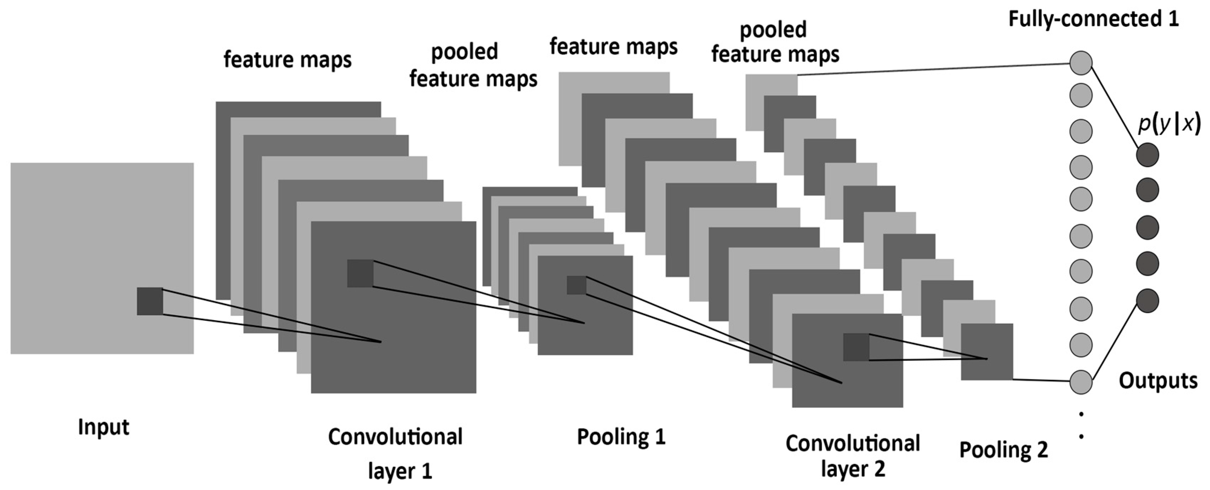
Practice 1: CNN
Setup Layers (Model)
Input Layer=Embedding Layer(128 * 7)
Output Layer (10000)
10000
128
7

Slide 24
Practice 1: CNN
Embedding Layer (Model)
Code
# Embedding self.emb_W = self.get_var(name='emb_W', shape=[self.vocab_size, self.emb_dim]) self.x_emb = tf.nn.embedding_lookup(self.emb_W, self.x)
Embedding Layer
128
7

Slide 25
Practice 1: CNN
Model
Add Embedding Layer
Setup Layers (CNN)
Make Loss and Optimization
Train Model

Slide 26
Practice 1: CNN
Setup Layers (Model)
Code
def build_model(self): x_emb_4d = tf.expand_dims(self.x_emb, -1) # expand dimension 1 for 3-d conv_f1 = self.get_var(name='conv_f1', shape=[3, self.emb_dim, 1, 256]) conv_b1 = self.get_var(name='conv_b1', shape=[256]) conv_l1 = self.leaky_relu(tf.nn.conv2d(x_emb_4d, filter=conv_f1, strides=[1, 1, 1, 1], padding='VALID') + conv_b1) conv_f2 = self.get_var(name='conv_f2', shape=[3, 1, 256, 256]) conv_b2 = self.get_var(name='conv_b2', shape=[256]) conv_l2 = self.leaky_relu(tf.nn.conv2d(conv_l1, filter=conv_f2, strides=[1, 1, 1, 1], padding='VALID') + conv_b2) conv_f3 = self.get_var(name='conv_f3', shape=[3, 1, 256, 256]) conv_b3 = self.get_var(name='conv_b3', shape=[256]) conv_l3 = self.leaky_relu(tf.nn.conv2d(conv_l2, filter=conv_f3, strides=[1, 1, 1, 1], padding='VALID') + conv_b3) self.text_vec = tf.reshape(conv_l3, [-1, 256]) dense_1 = Dense(128, dtype=tf.float32, name='dense_1') layer_1 = tf.nn.tanh(dense_1(self.text_vec)) self.out_layer = Dense(self.vocab_size, dtype=tf.float32, name='out_layer') self.word_prob = tf.nn.softmax(self.out_layer(layer_1)) self.out_y = tf.argmax(self.word_prob, 1)

Slide 27
Practice 1: CNN
Result
it: 550 | loss: 5.545 - 372.74s
it: 600 | loss: 5.561 - 397.48s
it: 650 | loss: 5.346 - 423.07s
it: 700 | loss: 5.202 - 448.06s
it: 750 | loss: 5.144 - 474.12s
test loss: 5.733
220 be

